Slide 1
Chapter 6
Cash Purchases

Slide 2
iMac 27” 8GB Memory
Listed Price: $1,999.00
Actual Price: $2,118.94

Slide 3
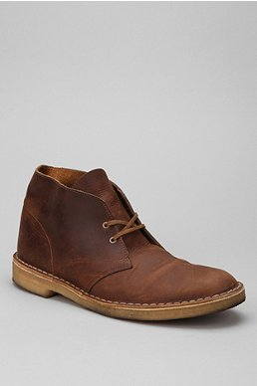
Clarks Desert Beeswax Boot
Retail Price: $120.00
15% off sale
Actual Price: $108.12

Slide 4
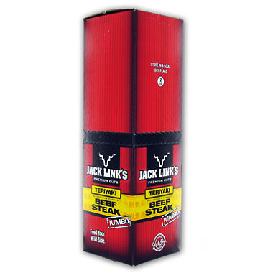
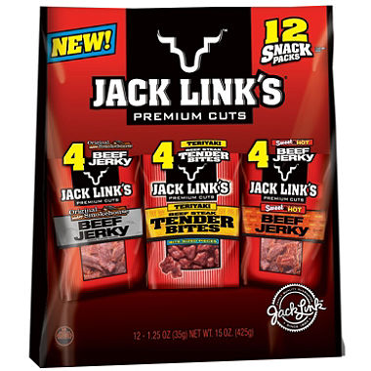
Jack Link’s Beef Jerky
←12PK, 1.25 oz. bags for $14.88
2 oz. stick, 12CT →
$28.98
$0.99 /ounce $1.21 / ounce

Slide 5
Section 6.1 – Sales Tax
Most states charge a Sales Tax on goods sold
Tax on the selling price of an item or service that you purchase
Pennsylvania: 6%
California: 8.25%
Delaware: No sales tax
http://www.taxpolicycenter.org/taxfacts/Content/PDF/state_sales_tax.pdf

Slide 6
Additional Sales Taxes
Cigarette Tax
$1.60 per pack of twenty
Malt Beverage and Liquor Tax

Slide 7
Sales Tax
Sales tax rates differ from state to state
Many states also permit county and city governments to add an additional tax to the state sales tax
Sales Tax =
(Total Selling Price) X (Sales Tax Rate)

Slide 8
What We Don’t Pay Sales Tax On…
In PA, we pay sales tax on all goods and services, with the exception of…
Clothing
Food (except for ready-to-eat)
Drugs
Textbooks
Sales for Resale Items
Residential Heating Fuels (gas, electric, firewood, etc.)

Slide 9
Example 1 – Sales Tax
Jimmy Trico bought a new iPhone6 for $299.99 and a phone case for $30.00. What is the total sales tax if Trico lives in Austin, Texas, where the state tax is 6.25% and the city tax is 2 percent?
Total selling price: 299.99 + 30.00 = $329.99
329.99 x (6.25% + 2.0%)
329.99 x (.0625 + .02)
329.99 x (.0825) = $27.22 sales tax

Slide 10
Example 2 – Sales Tax
Selling Price= $189.99
Sales Tax = $13.30
Find the Sales Tax Rate
Sales Tax = Selling Price x Sales Tax Rate

Slide 11
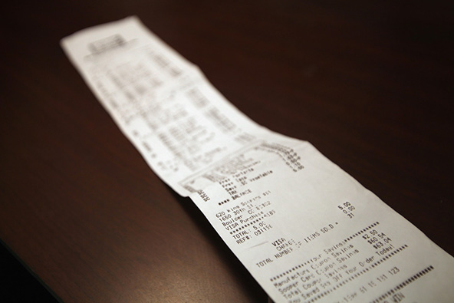
6.2 – Total Purchase Price
Most stores give you a sales receipt as
proof of purchase
Sales receipt shows the selling price of each item or service purchased, the total selling price, any sales tax, and the total purchase price
NOTE: the tax is computed on the combined state, county, and city tax rates

Slide 12
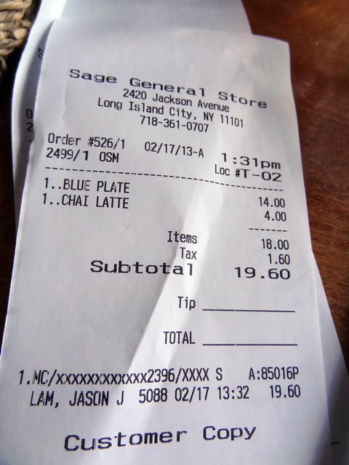
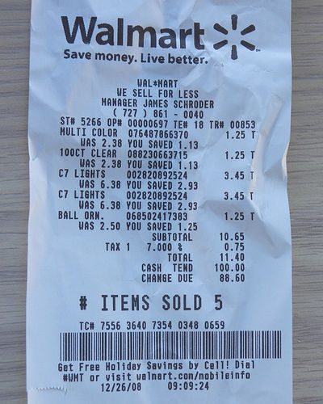

Slide 13
6.2 – Total Purchase Price
The total purchase price of an item is equal to the selling price plus the sales tax. Remember that:
Sales tax =
Total Selling Price x Sales Tax Rate
Total Purchase Price =
Total Selling Price + Sales Tax

Slide 14
6.2 – Example 1
A store in Madison, Wisconsin, advertised a smoke alarm for $24.95 and a fire extinguisher for $39.95. What is the sales tax if the combined state and city rate is 6%? What is the total purchase price?

Slide 15
Finish by the end of class…
Pg. 233, #3-12
Pg. 235, #3-15
Either TURN IN YOUR WORK or SHOW ME WHAT YOU FINISHED BY THE END OF CLASS. THIS IS BEING CHECKED FOR POINTS!

Slide 16
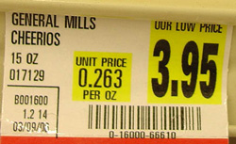
6.3 and 6.4 – Unit Pricing and Comparison Shopping
When we shop, we sometimes want to get the “better buy”
Unit Pricing is a system that allows shoppers to compare the prices of various items quickly and easily
Some stores give the unit price for their products

Slide 17
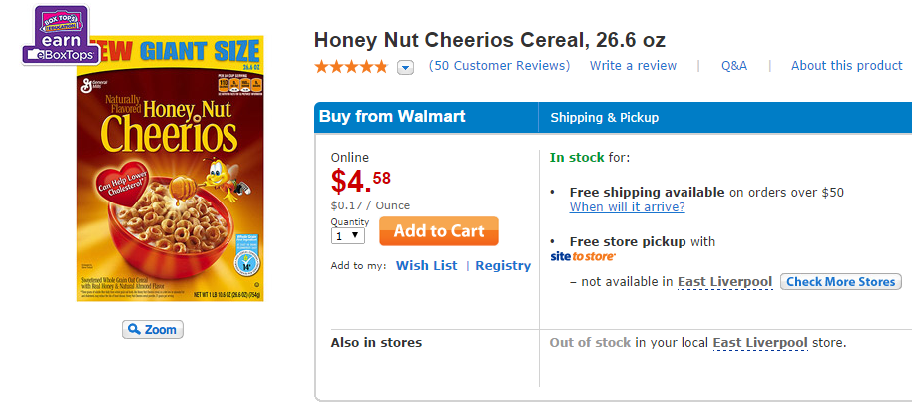
Walmart, CVS, Costco (and others) have agreed to display prices by unit of measurement, as well as by item, on their websites and mobile apps

Slide 18
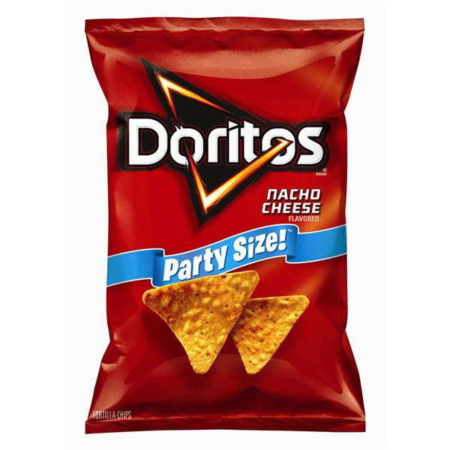
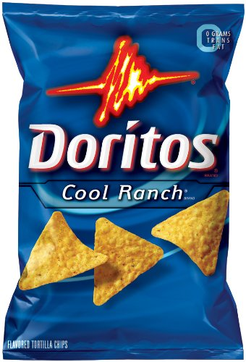
11 ounces, $2.98/bag
16 ounces, $3.98/bag
Which is the better buy?!?!?!

Slide 19
Unit Pricing and Comparison Shopping
We want to find out the unit price to see which size bag has more “bang for its buck”
UNIT PRICE = Price Per Item
Measure or Count

Slide 20
11 ounces, $2.98/bag
16 ounces, $3.98/bag
Unit Price = ($2.98)/(11)
Unit Price = ($3.98)/(16)
= $0.25 per ounce
= $0.27 per ounce

Slide 21
Example
Shane Burns purchased a 43.5-ounce can of coffee for $3.99, a 2-liter bottle of cleaner for $3.98, and a dozen oranges for $3.96. What is the unit price of the items to the nearest cent?
Coffee: $3.99 ÷ 43.5 = $0.0917 = $0.09 per ounce
Cleaner: $3.98 ÷ 2 = $1.99 per liter
Oranges: $3.96 ÷ 12 = $0.33 per orange

Slide 22
Unit Pricing and Comparison Shopping
If you are comparing the unit prices and end up with the same “rounded price”, compare the non-rounded prices.
Example: One bag of pretzels is $0.4578 per ounce and another is $0.4562 per ounce. Both round to $0.46 per ounce, but the 2nd is actually the better price per ounce
We can multiply by 100 to compare by cents instead of dollars in order to be more accurate with our pricing

Slide 23
Converting $ to ₵
Unit Price = $0.2584 per ounce
$0.2584 x 100 = 25.84 ₵ per ounce
Unit Price = $0.0014 per tissue
$0.0014 x 100 = 0.14 ₵ per tissue

Slide 24
Questions?
Pg. 238, #4-14 evens
Pg 240, # 4-12 evens
MAKE SURE YOU SHOW ME YOUR WORK BEFORE YOU LEAVE!!!!

Slide 25
Unit Price Review
A 24-ounce bag of Tortilla chips costs $5.95
($5.95) ÷ (24) = $0.25 per ounce
25 cents per ounce
A Kleenex box has 200 sheets in it for $4.25
($4.25) ÷ (200) = $0.02125 per sheet
2.1 cents per sheet

Slide 26
6.5 – Coupons and Rebates
Many manufacturers, stores, and service establishments offer customers discounts through coupons and rebates, or refunds
An incentive for customers to purchase a particular item in order to save money (coupon) or to get money back (rebate).

Slide 27
6.5 Coupons and Rebates
Coupons
Redeemed at the time of purchase
Rebates
Customer must mail in a rebate coupon along with the sales slip and the Universal Product Code (UPC) label from the items
Final Price = Total Selling Price – Total Savings

Slide 28
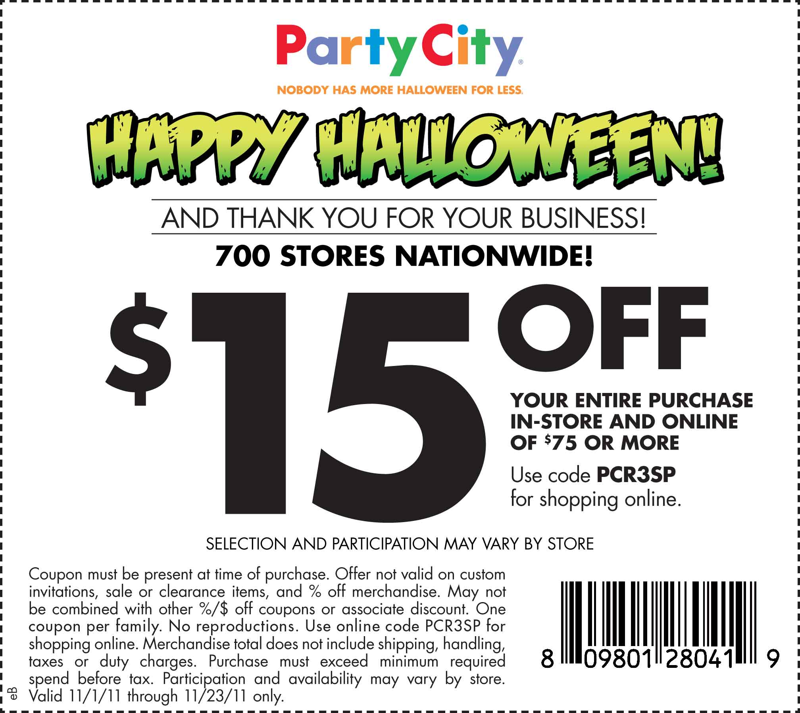
Coupon

Slide 29
Rebate

Slide 30
Example 1 – Coupons and Rebates
Bill Faix purchased a new set of tires for $399.99 and windshield wiper fluid for $10.99. He had a coupon for $50 off. What is the final price of the items?
Total Selling Price – Total Savings
($399.99 + $10.99) – ($50)
($410.98) – ($50) = $360.98 final price

Slide 31
Example 2 – Coupons and Rebate
A new XBOX game costs $60.00 with a mail-in rebate of $7.00. What is the final price after the rebate if an envelope costs $0.25 and a postage stamp costs $0.49?

Slide 32
Coupons and sales tax…
Suppose we buy a shirt for 39.99 and a tie for $20, but use a coupon for $10 off. The store also charges a sales tax of 6%. What is the total purchase price of the shirt?
STEP 1: ($39.99 + $20.00) = $59.99 total selling price
STEP 2: $59.99 - $10.00 = $49.99 sale price
STEP 3: ($49.99)x(0.06) = $3.00 sales tax
LAST STEP: $49.99 + $3.00 = $52.99 total purchase price

Slide 33
Rebates and sales tax…
Now suppose we buy a shirt for 39.99 and a tie for $20, but get a mail-in rebate for $10. The store also charges a sales tax of 6%. What is the total purchase price of the shirt?
STEP 1: ($39.99 + $20.00) = $59.99
STEP 2: ($59.99)x(0.06) = $3.60
STEP 3: $59.99 + $3.60 = $63.59
LAST STEP: $63.59 - $10 = $53.59

Slide 34
Coupons and Rebates - Practice
On Pg. 242, try numbers 6-16 evens
You have 10 minutes to complete!

Slide 35
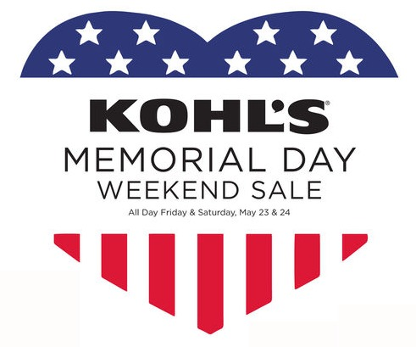
6.6 – Markdown
Stores often sell products at
sales prices
The markdown, or discount,
is the amount of money that
you save by purchasing a
product at the sale price
Markdown = Regular Selling Price – Sale Price

Slide 36
Example 1 - Markdown
Greg Leonard purchased a video camera at a sale price of $499.99. The regular selling price is $549.99. What was the markdown?
Regular Selling Price – Sale Price
($549.99) – ($499.99) = $50.00 markdown

Slide 37
Markdown
The markdown rate, or discount rate, of an item is its markdown expressed as a percent of its regular selling price
Businesses frequently advertise the markdown rate rather than the sale price
Markdown = Regular Selling Price x Markdown Rate

Slide 38
Example 2 - Markdown
Furniture World has a special on oak furniture at 40% to 55% off the regular selling price. Erica Park purchased an oak table at 40% off the regular price of $799. How much is the markdown?
Regular Selling Price x Markdown Rate
($799) x (40%) = $319.60 markdown
BE CAREFUL! This is not how much the table will cost, but it is how much is taken off the original price!

Slide 39
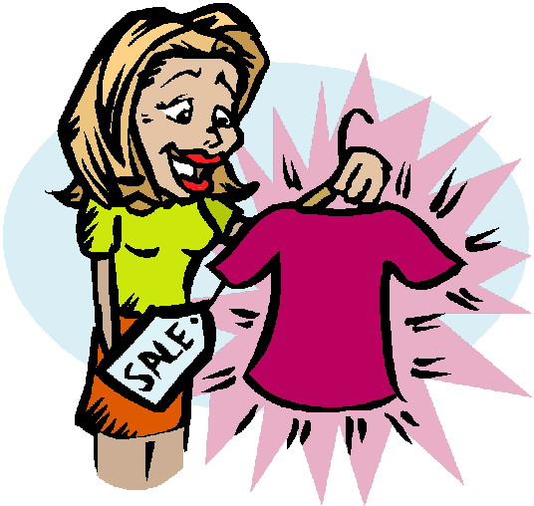
6.6 - Practice
Pg. 244,
# 6-22 evens

Slide 40
6.7 – Sale Price
For items on sale, some stores advertise the amount of markdown and the regular selling price
Some stores list the item as a stated percent off the regular price
Sale Price = Regular Selling Price - Markdown

Slide 41
6.7 – Sale Price
What if we know the markdown percent?
When you receive 25% off an item, you pay 75% of the selling price
NOTE: the regular selling price of an item is 100%
Thus, the percent paid is 100% minus the percent off
Sale Price = Percent Paid x Regular Selling Price
Percent Paid = 100% - Percent Off

Slide 42
Sale Price – Example 1
Debby Hacksaw has a 25 percent off coupon and is purchasing a watch that has a regular price of $125.00. What is the sale price for the watch? What is the sale price using the percent method?
Regular Selling Price x Markdown Rate
$125.00 x 25% = $31.25
$125.00 - $31.25 = $93.75 sale price
Percent Paid x Regular Selling Price
(100% - 25%) x $125.00 = $93.75 sale price

Slide 43
Example 2
A clothing store advertisement reads that you can save 66% off women’s fall collections. A dress with an original price of $152.00 is on sale for $51.68. Determine if this ad is correct
Markdown = $152.00 – $51.68 = $100.32
Markdown = Regular Selling Price x Markdown Rate
$100.32 = $152.00 x R
0.66 = R
so Markdown rate = 66%

Slide 44
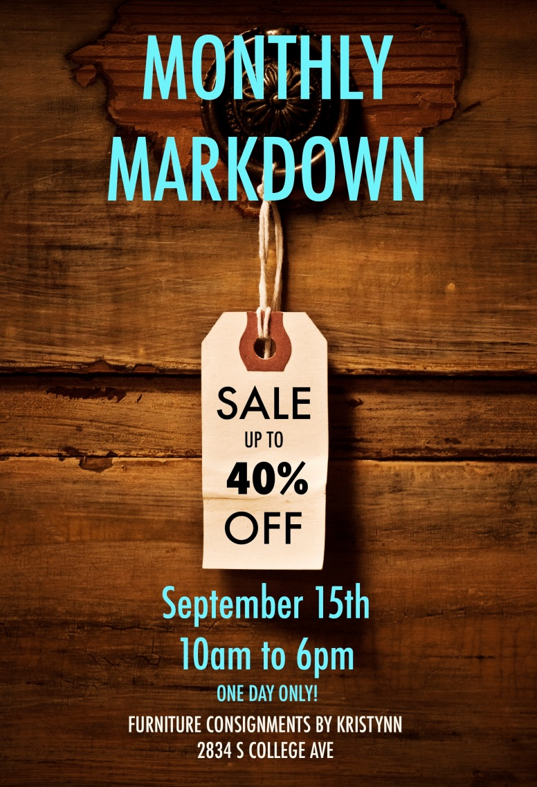
Sale Price
Pg. 247, # 5-13 ALL

